Slide 1

Critical Thinking
Lecture 1: Introduction to responsible research and innovation
Francesco Nappo
Department of Mathematics
AY 2024-25
School of Industrial and Information Engineering

Slide 2
Welcome to CTH
Introduction
Responsible research and innovation
Course requirements
Break
Intro to decision under risk (Alessandro)

Slide 3


Who am I?
Philosopher
Scientific methodology, applied ethics
Part of EFFEDIESSE – STEM Education Lab at the Math Department
Part of META – Social Sciences and Humanities for Science and Technology

Slide 4


Slide 5
Course overview
This course aims to develop ability to think critically, starting from your own work and behavior
A chance to reflect further on the problems that you are already thinking about – your current or predicted master’s research
Are you thoroughly analyzing your research problem, asking the right questions, carefully considering every relevant aspect, and anticipating the implications of your work on society?

Slide 6
Course overview
This course aims to develop ability to think critically, starting from your own work and behavior
More generally, a chance to reflect on how visions of science and innovation carry implicit ideas about public purposes, collective future, private and common good.
Being able to detect these ideas, analyze them, discuss them, and elaborate revised ideas based on people’s feedback.
This ability will give you an edge in any context.

Slide 7
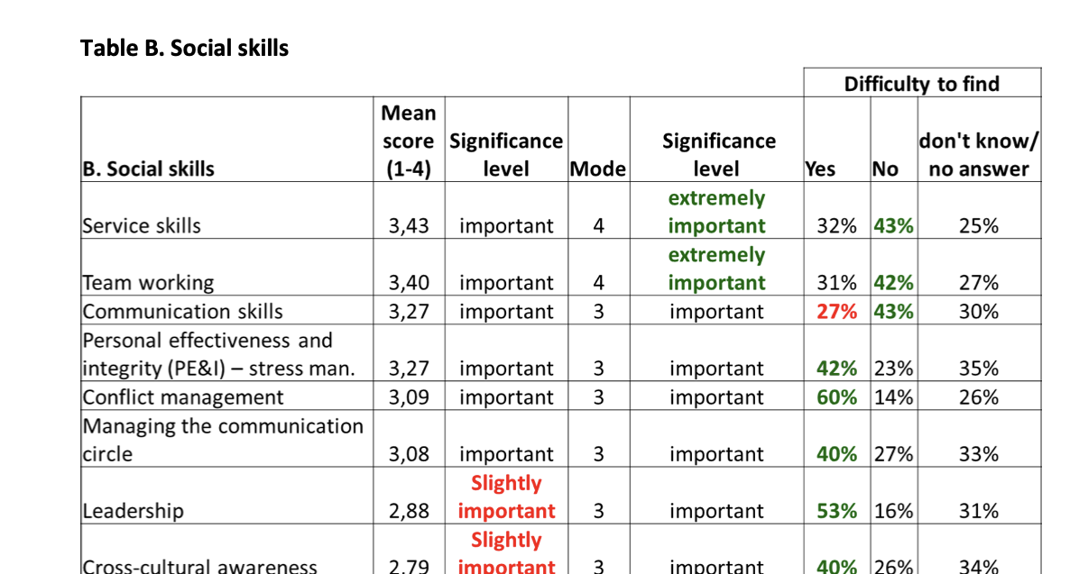

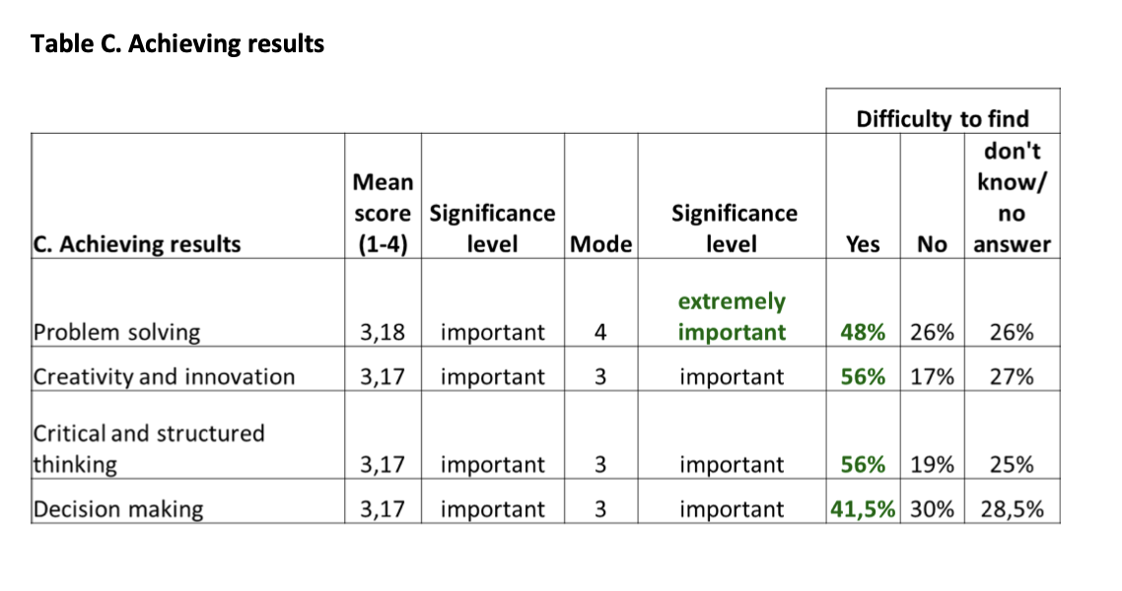
Critical thinking skills in business
Sample: 70 companies from all over EU

Slide 8
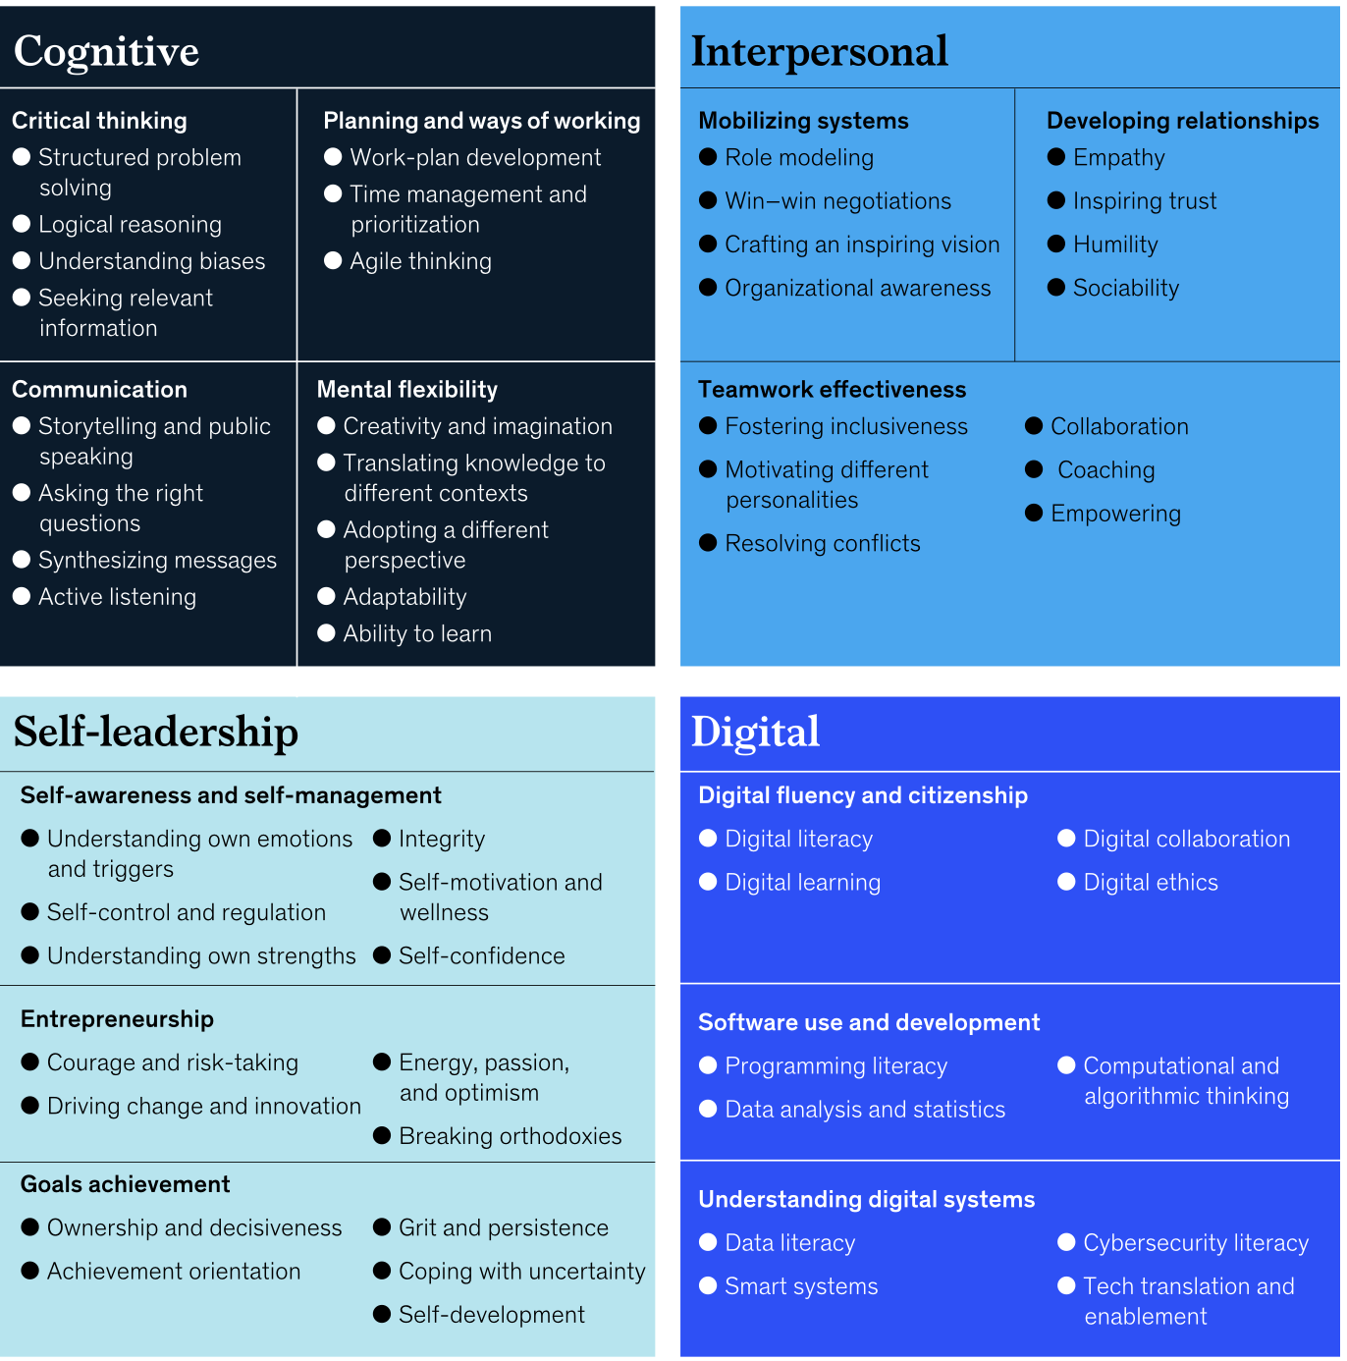
Continued
https://www.mckinsey.com/industries/public-sector/our-insights/defining-the-skills-citizens-will-need-in-the-future-world-of-work

Slide 9
Responsible research and innovation
The engineering sciences bring about deep and widespread changes in society, health, and environment
Responsible research and innovation (RRI) is about aligning research and technology towards the benefit of people - their dignity, health, well-being – and being mindful of the environment.
It does not mean that research and innovation should not aim at being profitable, but that profit is not viewed as ‘the’ purpose

Slide 10

What does RRI mean?
‘Rational’
But is that enough?
Expected utility theory says you should take the course of action that maximizes your preferences given the probabilities.

Slide 11
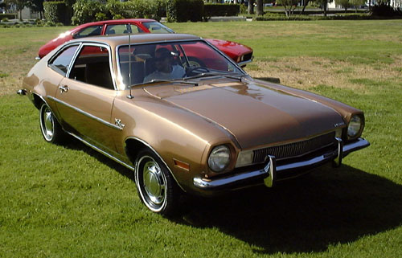
What does RRI mean?
‘Abiding by the laws’
Is that enough?
The Ford Pinto case (1970’s).

Slide 12
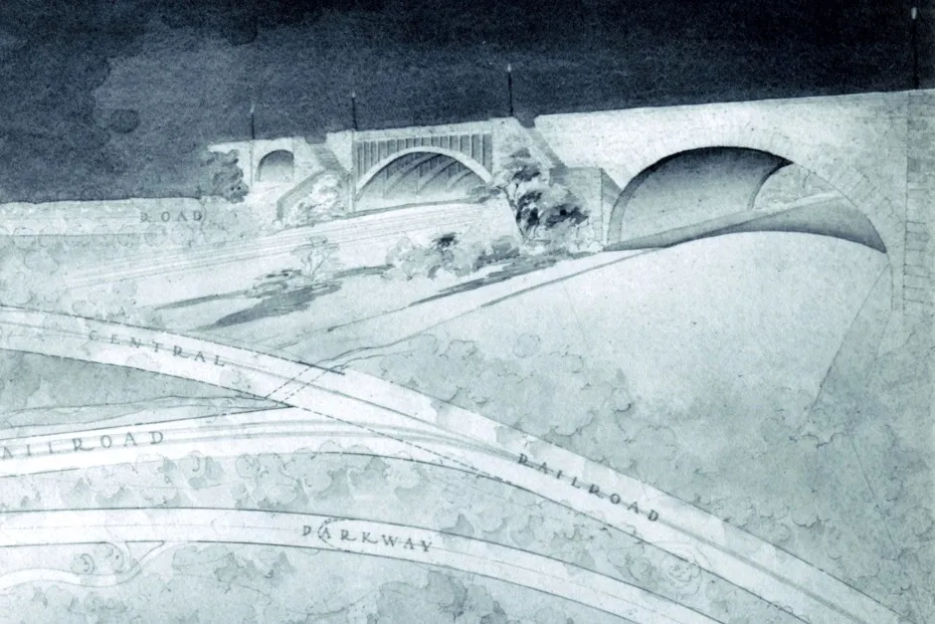
What does RRI mean?
‘Reflective of values held in society’
Is that enough?
Robert Moses’ parkways (1920’s).

Slide 13

What does RRI mean?
‘Aiming at ethically and socially valuable outcomes’
But how do we achieve that?

Slide 14

What does RRI mean?
Diverse & Inclusive
Anticipatory
Open & transparent
Timely & responsive to change

Slide 15
Objectivity and RRI
Creating knowledge and innovation in harmony with people’s values – but what if those values are wrong?
Should research and innovation meet people’s expectations then, or should it seek to correct them?

Slide 16
What does RRI mean to you?
Have you encountered RRI before? If so, in which context?

Slide 18
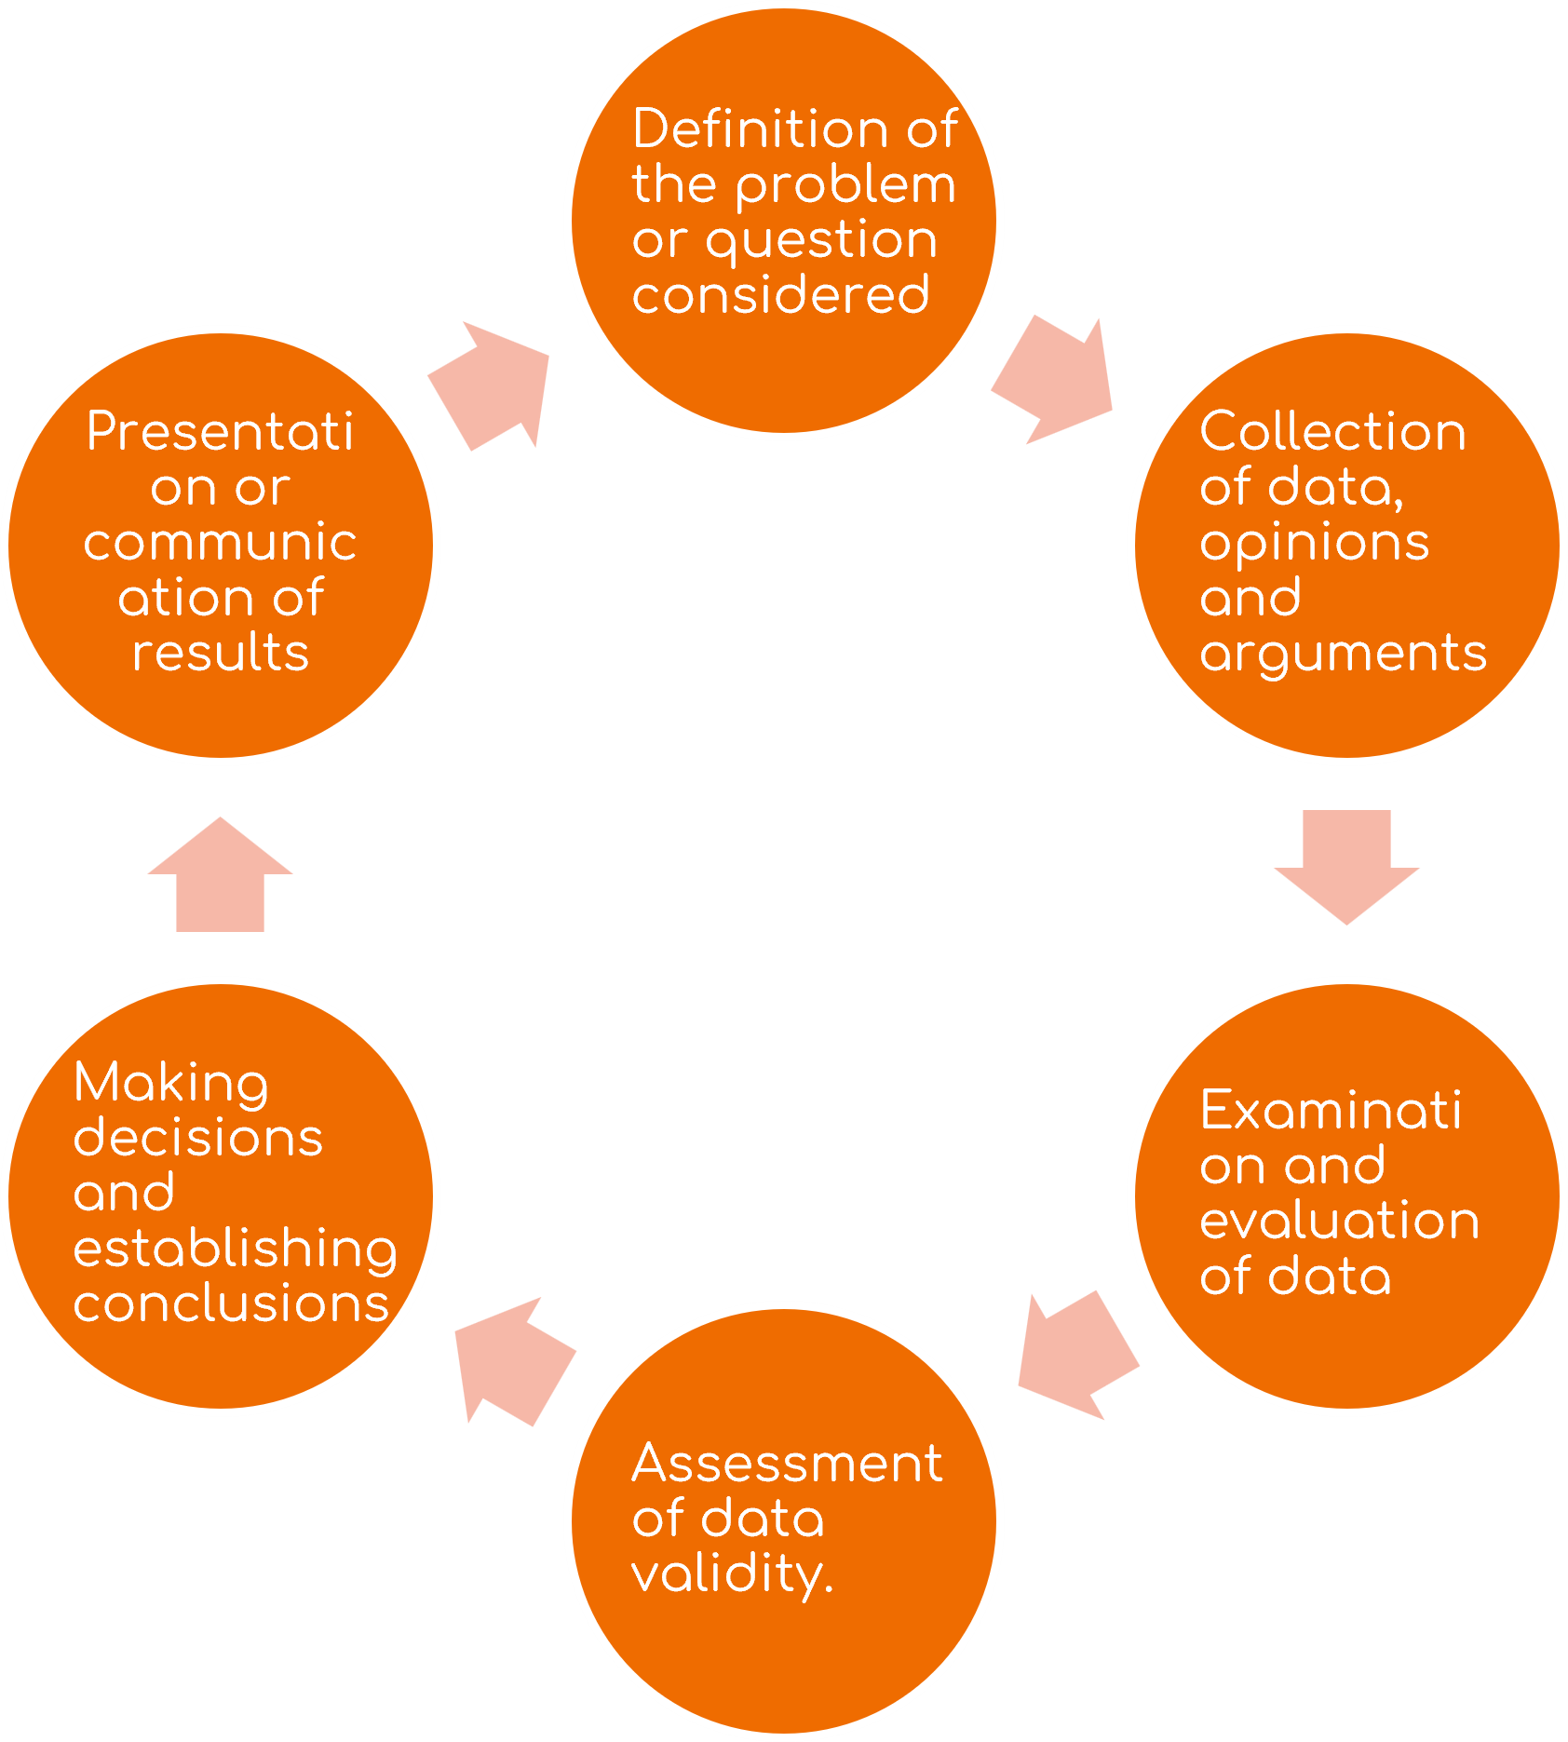
Problem solving

Slide 19
Course overview
03/03 Measurement and use of data
10/03 Modeling, testing hypotheses, and values
17/03 Uncertainty in research and innovation
24/03 Problems of social choice
14/04 Precaution and participation
28/04 Sustainability in research and innovation
05/05 Responsible communication
=> Schedule may be subject to change

Slide 20
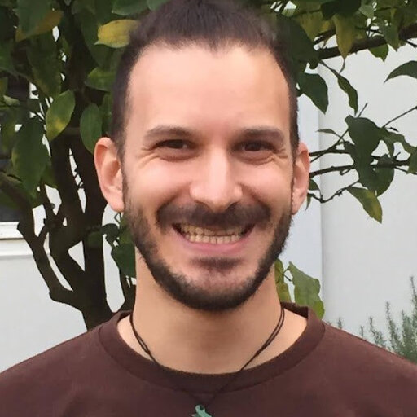
Your teaching assistant
Alessandro Demichelis
Philosopher
Expert in formal and social analyses of decision-making processes

Slide 21
The masterplan
I’m going to be discussing a variety of situations in science and technology where the problem of making rational, reflective choices arises – from the use of data to the choice of models to the design of artifacts, etc. – illustrating it with concrete cases
Spoiler: all of these situations involve risk and uncertainty…
Meanwhile, Alessandro will tell you about aspects related to the psychology and the logic of decisions under risk and uncertainty.
Your job: reflect on your experience and share it with us.

Slide 22
Course requirements
Participation (10%)
Not the same as attendance: ask questions, be active, be respectful
Group project (60%)
You’ll need to identify a problem of common interest with other classmates to apply critical thinking. Guidelines will be provided in due course. It is your responsibility to find a group of people to pursue a project together. Graded collectively.
Individual brief (30%)
You’ll each write a four-page paper reflecting on the methodological and ethical aspects of your current or predicted Master’s thesis research. Guidelines will be provided for this, too.

Slide 23
FAQs
I cannot attend any class nor do a group project
CTH is based on active learning education principles. I recommend taking a different class..
I can do group projects but cannot attend on a regular basis
After your group project presentation, you’ll be provided with a choice to keep your (presumably low) participation grade OR take a written test, worth 10% of final grade
Which materials are required for this class?
A copy of Resnik’s Choices: An Intro to Decision Theory is required. Electronic copy is fine. Slides, class recordings, notes, etc. will be all uploaded on WeBeep platform.

Slide 24
Getting help
=> Office hours: ask for an appointment!
06/05 Presentations help session (Alessandro)
12/05 Groupwork: Presentations
19/05 Groupwork: Presentations
26/05 Reports help session (Alessandro)

Slide 26
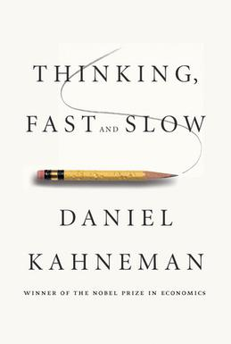
Thinking fast and slow

Slide 27
Thinking fast and slow
Linda is 31 years old, single, outspoken, and very bright. She majored in philosophy. As a student, she was deeply concerned with issues of discrimination and social justice, and also participated in antinuclear demonstrations. Please rank the following statements by their probability, using 1 for the most probable and 5 for the least probable:
Linda is a teacher in an elementary school
Linda is a bank teller
Linda is a member of the League of Women Voters
Linda is a psychiatric social worker
Linda is a bank teller and is active in the feminist movement

Slide 28
Dual process theory
Based on a variety of experimental tests and other evidence, Kahneman and Tversky theorize that human psychology is made out of two distinct systems:
System 1: Fast, instinctive and emotional thinking
System 2: Slow, deliberative and logical thinking
The evolutionary basis for each is different: system 1 comes from our kinship with other animals, whereas system 2 is human-only.

Slide 29
Thinking fast and slow
A cab was involved in a hit-and-run accident at night. Two cab companies, the Green and the Blue, operate in the city in which the accident occurred. You are given the following facts: 85 percent of the cabs in the city are Green and 15 percent are Blue. A witness identified the cab as Blue. The court tested the reliability of the witness under the same circumstances that existed on the night of the accident and concluded that the witness correctly identified each of the two colors 80 percent of the time. What is the probability that the cab involved in the accident was Blue?
(a) More than 70%; (b) Between 30 and 70%; (c) Less than 30%

Slide 30
Thinking fast and slow
«Many critics have insisted that in fact it is Kahneman & Tversky, not their subjects, who have failed to grasp the logic of the problem.» (Margolis 1987, p. 158)
«If a “fallacy” is involved, it is probably more attributable to the researchers than to the subjects.» (Messer & Griggs 1993, p. 195)
«When ordinary people reject the answers given by normative theories, they may do so out of ignorance and lack of expertise, or they may be signaling the fact that the normative theory is inadequate.» (Lopes 1981, p. 344)

Slide 31
Alternative explanations
There are subtle linguistic and pragmatic features of the problems:
Morier and Borgida (1984): the unusual conjunction “Linda is a bank teller and is active in the feminist movement” prompts an interpretation of “Linda is a bank teller” as “Linda is a bank teller and is not active in the feminist movement.”
Gigerenzer and Hoffrage (1995): the base rate problem is too unusual for people. They rely on natural frequencies, where the marginal frequency is the same as the frequency of the population. That is how people usually get to learn things. It makes sense from an evolutionary viewpoint

Slide 32
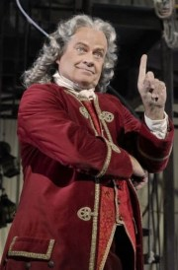
The Great Rationality Debate
Panglossians v meliorists
or
Populist v elitist
«The populist strategy, favored by Cohen (1981), is to emphasize the reflective equilibrium of the average person. . . . The elitist strategy, favored by Stich and Nisbett (1980), is to emphasize the re- flective equilibrium of experts» (Thagard 1982)

Slide 33
One question for you to think about
To what extent do theories of rational behavior – instrumental rationality, axioms of probability and rationality under risk, cost-benefit analyses etc. – and/or moral theories tell us something informative about what is rational and responsible behavior in concrete situations – such as the ones that you will confront in your engineering careers?
«Rationality in the adaptive sense, which is used here, is not rationality in the normative sense that is used in studies of decision making and social judgment» (Anderson 1990:31)

Slide 34
Immediately after the break
Alessandro will tell you more about decisions under risk..

